Slide 1


Project 1: Strategy and Decision Automation
Team 2: Kuma, Marcus, Mike and Kunal (K2M2)

Slide 2
Executive Summary
K2M2 Lending: Provide personal loans to individual consumers
Problem
Currently the analytics is reviewed manually using excel which is prone to human error
Reviewing the big data manually is costly and time consuming
Delay in management actions
Solution
Build an automatic analysis tool for the management to make profitable decisions
Management has access to timely data to make swift strategic decisions
Data Type
Loan data for personal loans focused on debt consolidation, home improvement etc.
Data Range: YTD 2022

Slide 3
Executive Overview
Kuma Lin: Accounting Manager
Mike Mozeko: Sales Manager
Kunal Sood: Marketing Manager
Marcus Cudjoe: Chief Credit Officer

Slide 4
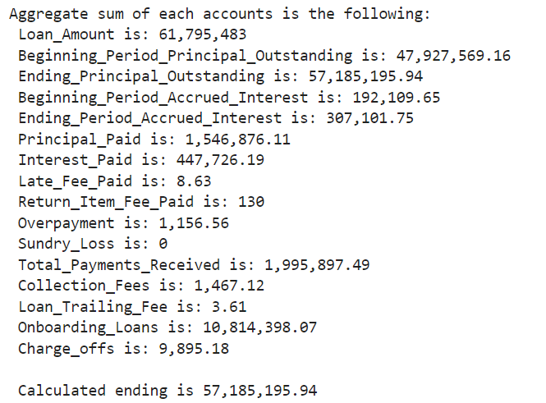
Aggregation of Loan and Related Accounts

Slide 5
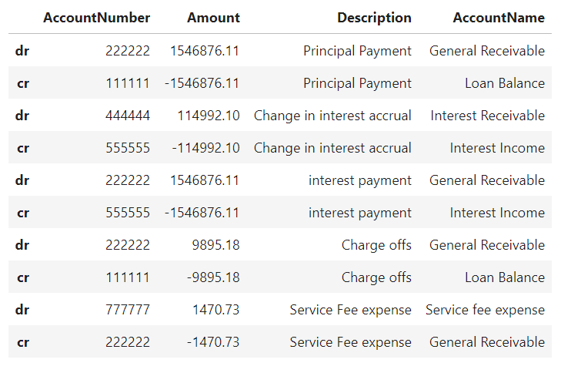
Journal Entry Form

Slide 6
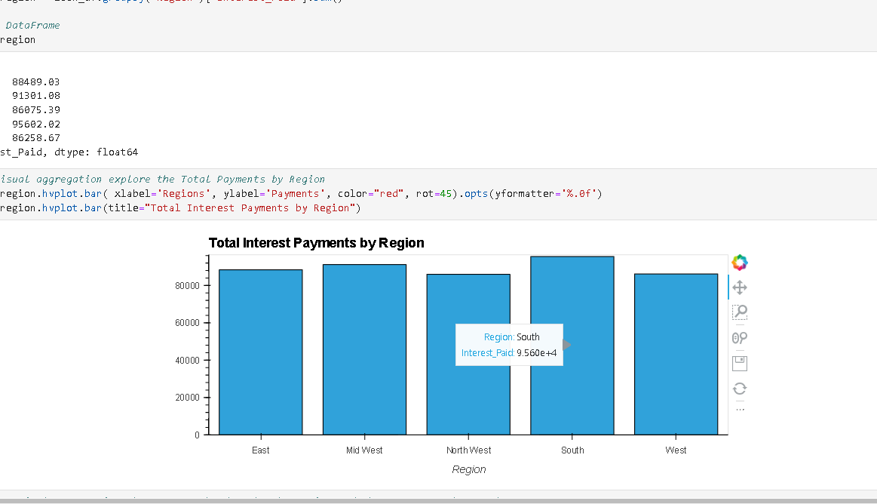
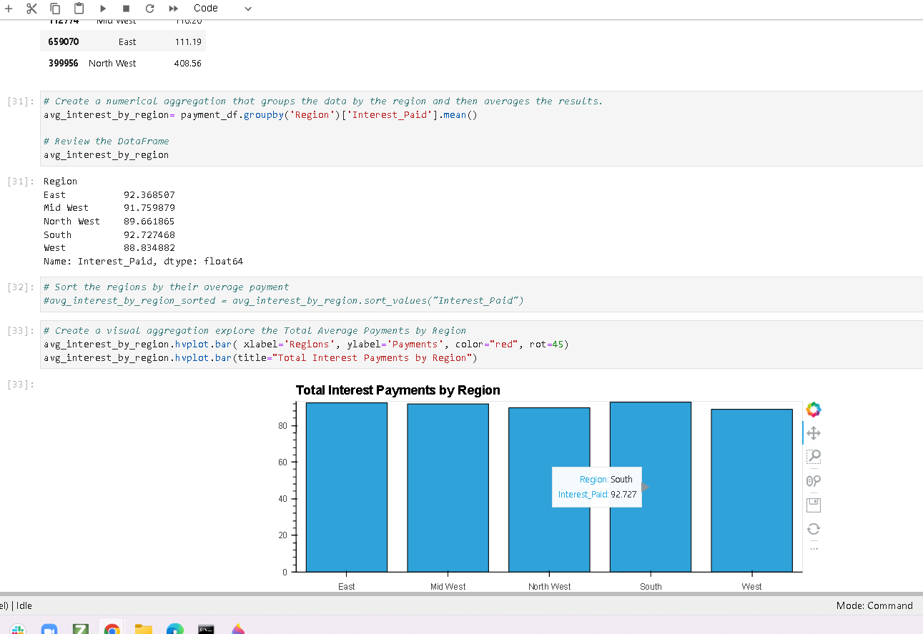
Sales Opportunities

Slide 7
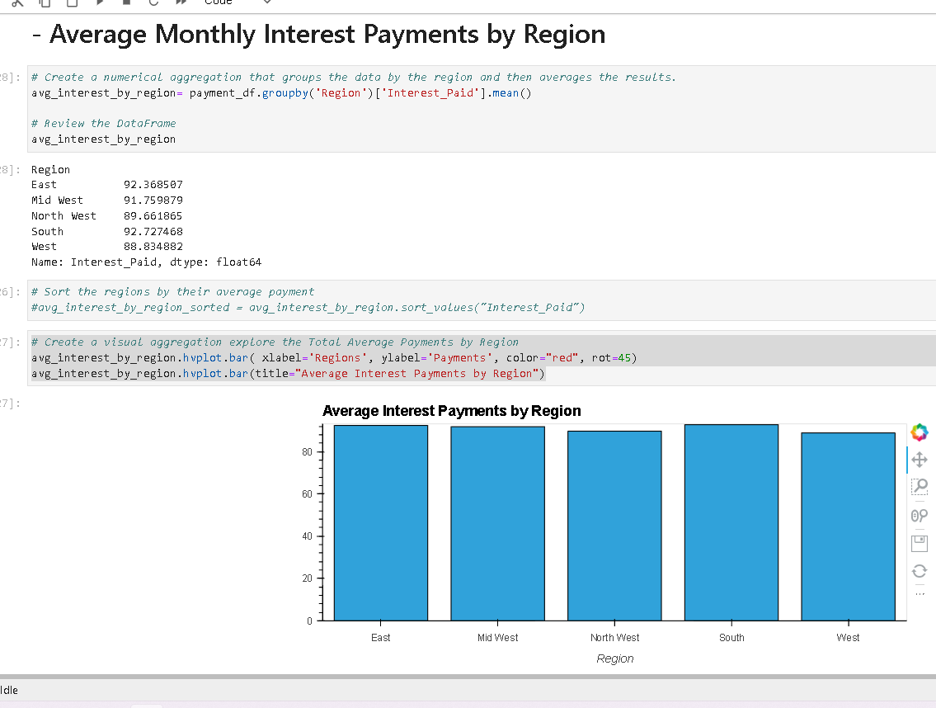
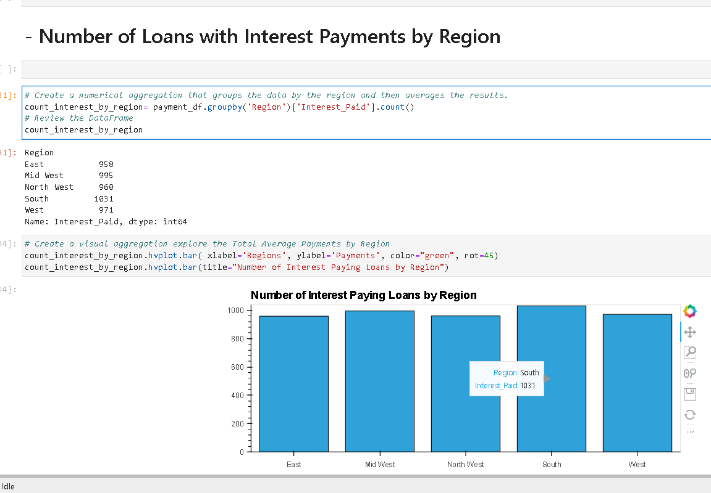
Sales Opportunities

Slide 8
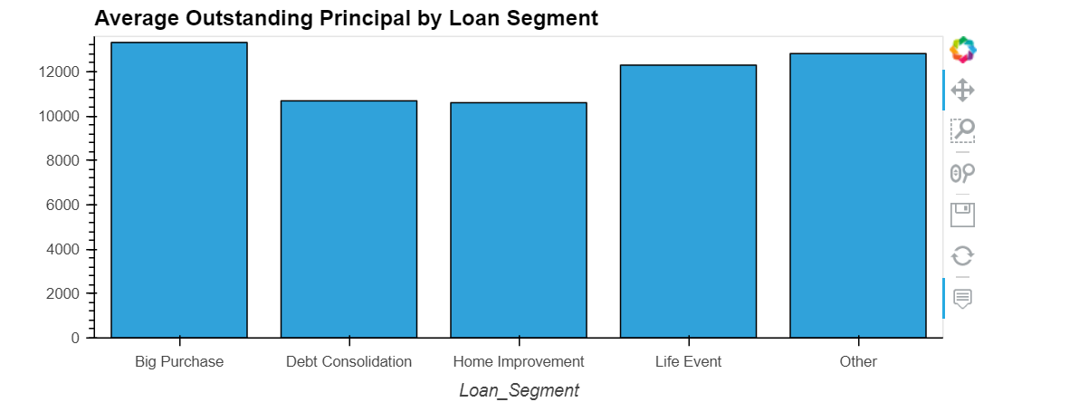
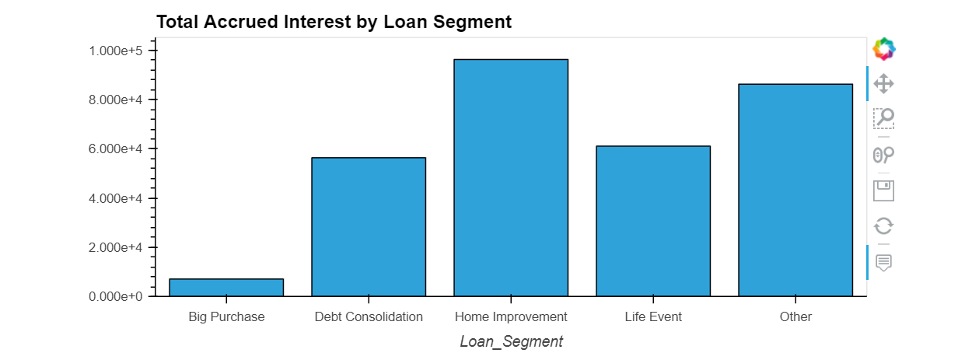
Marketing Opportunities
Based on review, we see few opportunities for market to explore:
Significant cross-sell opportunity for people in big purchase segment, given the loan volume in the segment – cross sell can be done through proactive email campaigns
Work with CCO and Accounting team, to identify segments where we can increase interest for debt consolidation loans

Slide 9
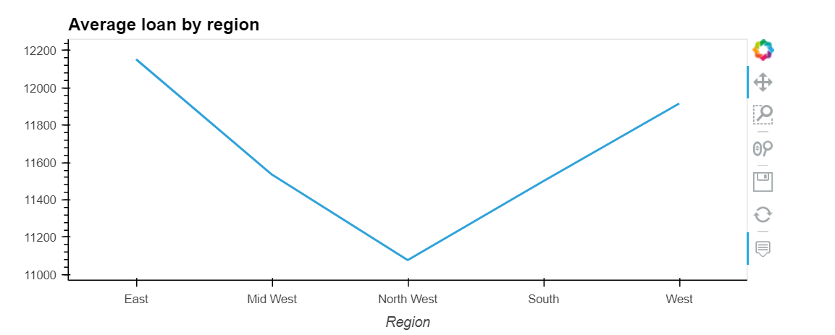
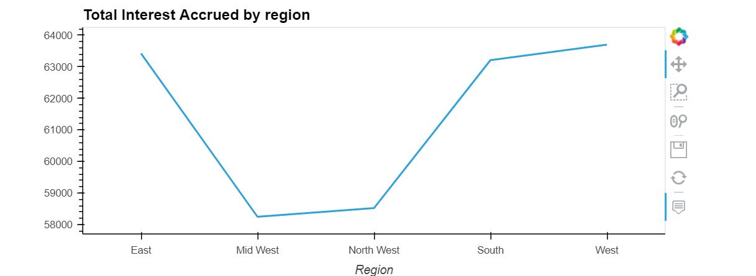
Marketing Opportunities
Marketing can expand more targeting in North-West Region to increase sales in that region, West region is where we get most income from, use that as proxy to explore marketing ideas in other regions

Slide 10
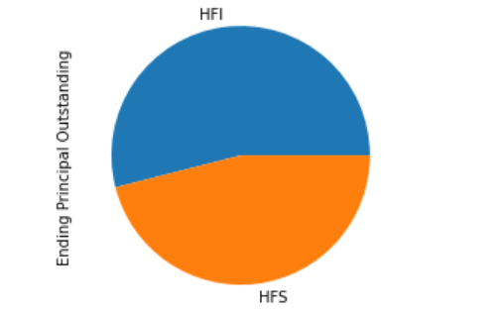
Portfolio Health
Over the HFI and HFS comparison
Status of most of the loans DPD vs FICO, DPD vs loan segment
Overall health of the portfolio

Slide 11
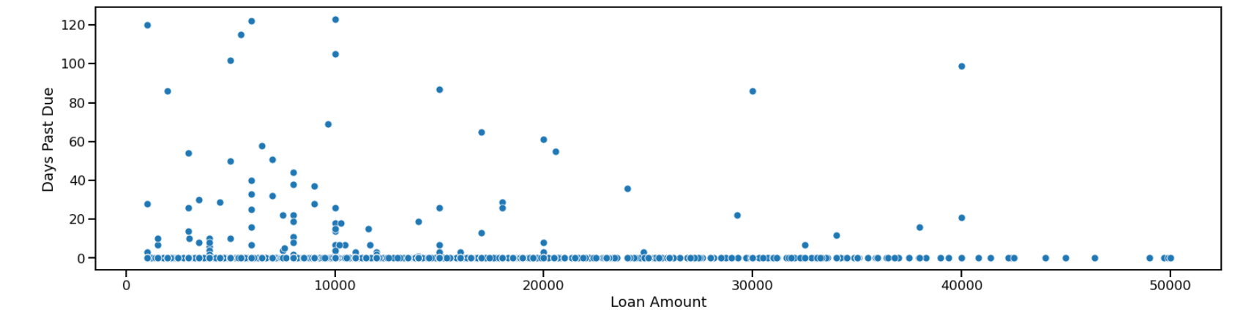
Portfolio Health

Slide 12
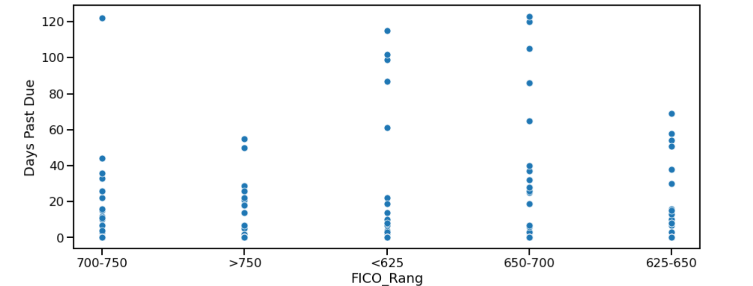
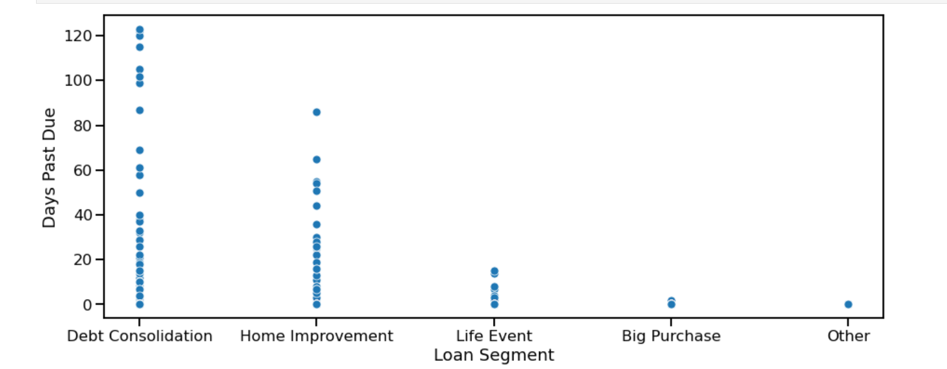
Portfolio Health

Slide 13
Summary
With this tool:
The solution to this problem has been proven successful and made our workflow more efficient
Future improvements to the automation tool:
Expand from analyzing YTD data to multiple period (historical data) for vintage analysis
Management will have full access to data to make quick decisions
Marketing can switch channel and regional strategies quickly
Credit organization can introduce risk strategies to mitigate losses
Helps improve revenue and profitability at enterprise level

